Slide 1
Api Marketplace “Golden Wallet”
1 | Description
2 | Terminologies
3 | Key Features
4 | Process Workflow
5 | Key Inputs/Outputs

Slide 2
Description

Slide 3
Descriptions
What is the API Marketplace?
A Centralized platform to expose APIs for mutual fund investments.
Enables ARB subsidiaries to offer mutual fund services through their digital channels.
What is a Digital Gold Wallet?
Explain the concept of a digital gold wallet as a secure and convenient way for customers to buy, sell, and hold gold in a digital, paperless form.
Emphasize that it removes the need for physical storage, logistics, and security concerns associated with physical gold.
How Will It Be Used?
Describe the product's function from the consumer's (business client's) perspective.
Explain that the consumer will use the provided APIs to seamlessly integrate gold buying, selling, and management functionalities directly into their own digital channels for their end-users.
Show how this enables their customers to have a dedicated digital account for their gold holdings.
How Will It Be Used?
Describe the product's function from the consumer's (business client's) perspective.
Explain that the consumer will use the provided APIs to seamlessly integrate gold buying, selling, and management functionalities directly into their own digital channels for their end-users.
Show how this enables their customers to have a dedicated digital account for their gold holdings.
Key Advantages of a Digital Gold Wallet
Convenience: Manage gold anytime, anywhere on a mobile or web app.
Security: Gold is held securely for your customers, without the risks of physical ownership.
Accessibility: Buy and sell gold in small, affordable amounts.
Investment: Easily investment portfolios with gold.

Slide 4
Terminologies

Slide 5
Terminologies- Business Definitions
Gold Wallet | A digital account that allows an end-user to buy, sell, and hold gold in a paperless form.
Subscription(Buy Gold) | The process by which an end-user initiates the purchase of a specific quantity of gold to be added to their digital wallet.
Redemption(Sell Gold) | The process by which an end-user sells a specific quantity of gold from their digital wallet for the equivalent value in currency.
Customer Portfolio Holdings | "List Customer Paper Gold Wallet Details" API, this term refers to the specific details of a customer's gold wallet, including the current amount of gold held, its status, and the commodity type. It is the record of what the end-user currently possesses.
Customer Portfolio Holdings | The detailed record of all investment units owned by a customer, including fund names, quantities, acquisition dates, and related attributes, representing their current positions in the investment pool.
Portfolio Performance | The "List Gold Rate History" and "Inquire Gold Rates" APIs provide the data needed to calculate and display this. This term represents the change in value of the customer's gold holdings over time.

Slide 6


Key Features – Business Perspective

Slide 7
Key Features
Subscription Capabilities:
Access to a complete and UpToDate catalogue of available bullions with relevant attributes.
Automated eligibility and suitability checks before allowing a gold purchase.
Flexible investment amounts based on the bullion's minimum and maximum thresholds.
Immediate confirmation of successful subscriptions with unique transaction IDs.
Redemption Capabilities:
Ability to request a partial or full withdrawal from owned gold holdings.
Handling of settlement timelines according to the product's operational rules.
Status tracking from request initiation to completion.
Portfolio Management:
Consolidated view of all customer holdings across multiple wallets.
Real-time updates of gold quantities, valuations, and asset composition.
Exportable reports for compliance and record-keeping.
Reporting & Notifications:
Transaction summaries for subscriptions and redemptions.
Periodic performance statements for each customer portfolio.
Alerts for key events such as rate changes, dividend distributions, or product suspensions.

Slide 8
Process Workflow

Slide 9
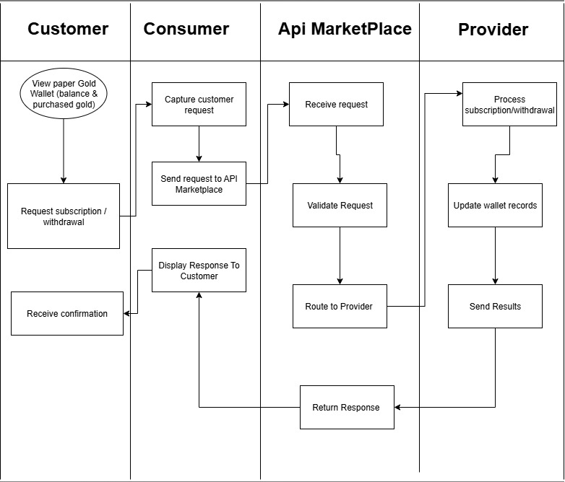

Slide 10
Inputs & Outputs – Business Keys

Slide 11
Purpose: Explain what the client needs to provide and what they will get from the APIs.
Inputs (Business Perspective):
Customer identification details (for KYC/Onboarding) based on the CIC parameter.
Gold selection and subscription/redemption details (bullion type, amount) based on transaction inputs.
Outputs (Business Perspective):
Gold details and pricing data (GoldRateHistoryList, TransactionKey with rate information).
Subscription/redemption confirmation and status
Portfolio summaries and performance reports (List Customer Paper Gold Wallet Details, derived from List Gold Rate History).
Notifications on transactions and dividends (based on the Confirmation Status Callback API).

